Slide 1

STAR CONSTRUCTION
Er.YOGESH LADIYA
yraj9496@gmail.com
9713620232
SAGAR

Slide 2
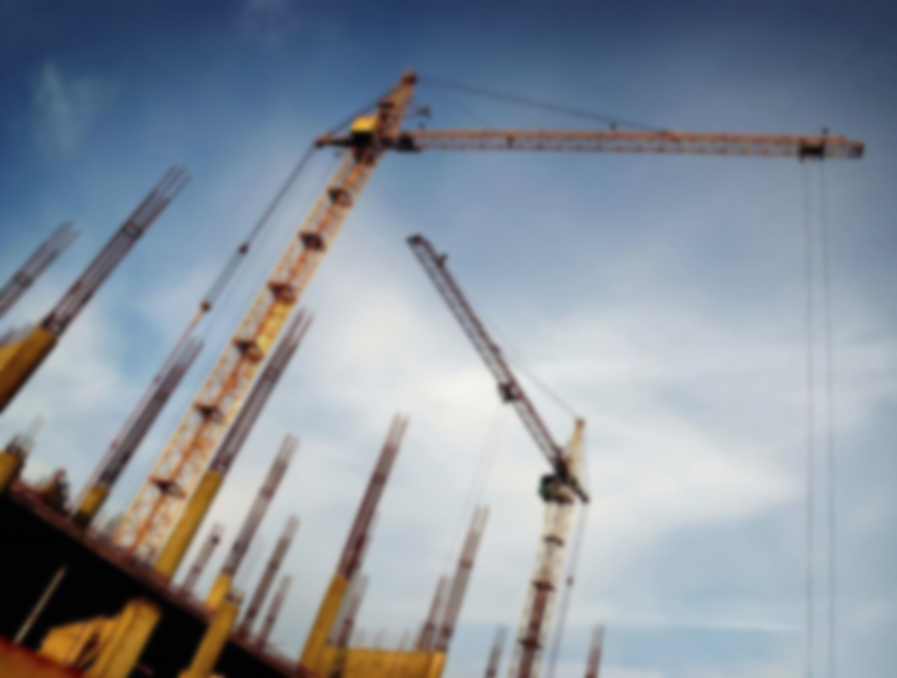
About Idea – Construction Related all the work and rental facilities machineries workers etc.
Details – We provide a all types of construction related works and also rental facilities machineries, And provide all types of related workers on client demand with the help of our website and also our APP
Idea – Theme
Service

Slide 3
Problem
Mainly people facing problem about construction related workers because it can not be easily available for every place and Equipment machinery are also not easily available for everyone.
Materials and supplies: from construction materials like cement, steel, bricks, to essential supplies and all type of electrical work.
These all are the problem facing people related to construction.
Solution
We provide a comprehensive selection of construction equipment and machinery on rent.
Skilled labor : we can connect you with skilled and experienced construction workers, including architects.
We are connected people any time for any work related with construction we reach every where with the help of website, App queries and also connected with phone.

Slide 4
Aim/Vision/Goal
Aim: our aim is to deliver exceptional construction projects that exceed client expectations, while maintaining a strong focus on safety, sustainability, and cost effectiveness.
Vision: to be a leading provider of high quality construction services known for our commitment to excellence innovation and client satisfaction.
Goals :
1. customers satisfaction: achieve a high level of customer satisfaction by consistently delivering project on time within budget and to the highest quality standard.
2. innovation and technology : embrace innovation and leverage cutting edge technologies to improve construction processes enhance efficiency and provide added value to our client.
3. Market expansion : identify and pursue opportunity for strategic growth and market expansion both geographically and interms of project complexity and size.
4. collaborative partnership : build strong long term relationship with client sub contractor suppliers and other stake holders based on trust integrity and collaboration.

Slide 5
Services
We provide typically offers a wide range of services related to building, renovating, and maintaining structures. Rental facilities machinery skilled labor.
New construction : We handle the entire process of building new structures, including residential homes, commercial buildings and industrial facilities. Also handle tasks such as site preparation foundation construction, framing, electrical and plumbing installation and finishing works.
Renovation and Remodeling.
General construction.
Structural work.
Road work.
Interior and Exterior Finishes. ETC………..

Slide 6
Competitor or Target Group
Competitors can vary depending on the specific services and markets. we provide all the facilities, services, also equipment machinery, skilled labor on rent.
As for target group, we focus on specific customer segments depending on there expertise and offerings. We target residential homeowners, commercial property developers, government entities, and infrastructure projects.
We are handle all the problems related to work and searching, focusing for new idea for grow our company.

Slide 7
Revenue or Profitability
Contracts and Bidding: we can participate in bidding processes to secure contracts for construction projects.
Example for 5000Sft Building with all the facilities included. Rough idea this is not actual estimate because it is also depending upon client demand.
Service Cost=90lac
Expenses =5lac
Investment=71lac
Profit= 9lac

Slide 8
Other Important Remark
Scalability: By investing in scalable practices, such as streamlined processes, technology integration and workforce management our company can enhance productivity and accommodate expanding operations.
Social Impact:
Job creation.
Infrastructure Development.
Environmental Sustainability.
Safety and Well being.
Social Initiatives.
Employment Generation:
Increase project volume.
Collaborate with subcontractors.
Problem Solving:
Identify the problem.
Gather information.
Analyze the situation.
Develop solutions.
Continuous improvement.

Slide 9

Thank you

